Slide 1
Welcome! Advanced Java
Introduction

Slide 3
Let's Talk About
In this chapter, we will learn about:
Logging
Logging best practices

Slide 4

Logging
Logging
Logging Best Practices
Exercise

Slide 5
Why Is Logging Important?
Logging is vital to software maintenance
It provides important information for monitoring production systems
Log files allow the detection and diagnosis of production issues
Logging is not just a debugging tool

Slide 6
Logging Levels
Logging system provided logging levels
It is important to log information at the correct level
Logging levels are:
ERROR - something has gone very wrong and the system cannot operate
WARN - something has gone wrong but the system can still operate
INFO - an important business process has completed
DEBUG - developer level information
Needs to be switched off in production
TRACE - detailed logging for developers and early production monitoring

Slide 7
What Gets Logged?
Each logging message contains several pieces of information
Logging date and time
A thread identifier
Log level
Class name
Log message
May contain values of variables

Slide 8
SLF4J
Simple Logging Façade 4 Java (SLF4J)
Provides a logging API in slf4j-api.jar
Actual logging framework is plugged in at deploy time
By adding the slf4j binding and the framework jar files to the classpath
import org.slf4j.Logger;
import org.slf4j.LoggerFactory;
public class Account {
private Logger logger ;
public Account {
logger = LoggerFactory.getLogger( getClass() ) ;
logger.info( "Account created" ) ;
}
}

Slide 9
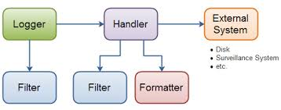
Logging Frameworks
There are a number of logging frameworks
Can be used with SLF4J
Can also use the framework API
log4j one of the original logging frameworks
slf4j-simple simply logs to System.err
java.util.logging part of JDK from 1.4
logback faster and lighter replacement for log4j

Slide 10
Logging Frameworks with SLF4J
Add binding and implementation jar files to the classpath to use frameworks
log4j requires slf4j-log4j12.jar and log4j.jar
slf4j-simple requires slf4j-simple.jar
java.util.logging requires slf4j-jdk14.jar
logback requires logback-classic.jar and logback-core.jar
SLF4J requires that one and only one binding jar file be added to the classpath

Slide 11
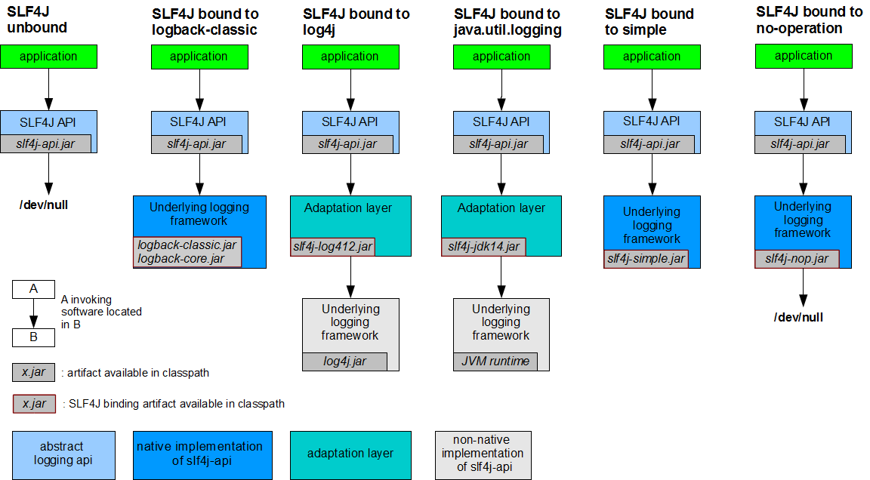
slf4j

Slide 12
Log Messages
SLF4J provides a number of logging methods
Variants of error(), warn(), info, debug() and trace() methods
These allows parameters to be substituted using {}
Can provide 1, 2 or multiple parameters
Multiple parameters need to be objects uses ...
isErrorEnabled(), isWarnEnabled(), isInfoEnabled(), isDebugEnabled() and isTraceEnabled()
logger.info( "Log message" ) ;
logger.info( "Message value {}", value ) ;
logger.info( "Message value {} and {}", value1, value2 ) ;
logger.info( "Message {} {} {}", value1, value2, value3 ) ;

Slide 13
Loggers
Logback supports multiple loggers
There is always a root logger
Other loggers can be defined they are named in a hierarchy
root
com.gs
com.gs.accounts
Loggers have a logging level
Only messages with the logger's logging level and above get logged
If a logger's level is not defined it inherits its parent's level
The root logger's level defaults to DEBUG
Logger logger = LoggerFactory.getLogger( "com.gs" ) ; Logger logger = LoggerFactory.getLogger( getClass() ) ; // Logger name is class name

Slide 14
Logback Configuration
Logback looks for a configuration file on the classpath
logback.groovy
logback-test.xml
logback.xml
If no configuration found it defaults to a basic configuration
It logs to the console
Java API can also be used for configuration

Slide 15
Layouts and Encoders
Encoders format the log messages into byte arrays
Layouts convert byte arrays to strings
Encoders and Layouts
Can be configured in the configuration file
Can be custom Java classes
There are several defined encoders
PatternLayoutEncoder
LayoutWrappingEncoder
There is a PatternLayout

Slide 16
Layout Patterns
Layout patterns are defined using format strings
Logger %logger{length}
Given logger com.gs.accounting.Account
%logger gives com.gs.accounting.Account
%logger{0} gives Account
%logger{5} gives c.g.a.Account
%logger{20} gives c.g.accounting.Account
Dates and times %d{HH:mm:ss} or %date{HH:mm:ss}
Components are yyyy MMM ddd HH mm ss SSS
<pattern>%d{HH:mm:ss.SSS} [%thread] %-5level %logger{42} - %msg%n</pattern>

Slide 17
Layout Patterns (continued)
Layout patterns are defined using format strings
Thread name %thread
Logging message %msg
Logging level %level
Platform dependent newline %n
Can also left or right pad with spaces
%5level left pads to 5 spaces
%-5level right pads to 5 spaces
<pattern>%date{HH:mm:ss.SSS} [%thread] %-5level %logger{42} - %msg%n</pattern>

Slide 18
Appenders
Appenders are named objects which write log messages
They can be configured in the configuration file
They can be custom Java classes
There are several defined appenders
ConsoleAppender
OutputStreamAppender
FileAppender
Appenders require an encoder
Defaults to PatternLayoutEncoder
<appender name="STDOUT" class="ch.qos.logback.core.ConsoleAppender"> <encoder> <pattern>%d{HH:mm:ss.SSS} [%thread] %-5level %logger{42} - %msg%n</pattern> </encoder> </appender>

Slide 19
File Appenders
File appender example
<appender name="FILE" class="ch.qos.logback.core.FileAppender"> <file>/var/log/account.log</file> <append>true</append> <encoder> <pattern>%d{HH:mm:ss.SSS} [%thread] %-5level %logger{42} - %msg%n</pattern> </encoder> </appender>

Slide 20
logback.xml
The configuration file
Assigns appenders to loggers
Assigns levels to loggers
<configuration> <appender name="STDOUT" class="ch.qos.logback.core.ConsoleAppender"> <encoder> <pattern>%d{HH:mm:ss.SSS} [%thread] %-5level %logger{42} - %msg%n</pattern> </encoder> </appender> <logger name="com.gs.accounting" level="WARN"/> <root level="INFO"> <appender-ref ref="STDOUT" /> </root> </configuration>

Slide 21
Logging
Logging
Logging Best Practices
Exercise

Slide 22
Cost of Logging
Logging can be expensive
Formatting can invoke data type conversion, toString, and string concatenation
Output devices are slow
There are ways to reduce the cost
Identify whether the information is likely to be logged
Use the correct API calls which don't perform string operations until runtime
if ( logger.isDebugEnabled() ) logger.debug(“…”)
The may be legal requirements which require a level of logging

Slide 23
Reducing Logging Cost
Think about the cost of the logging
Compare the two logging statements
What is the cost difference between the two?
What is the cost difference if the log level is disabled?
logger.debug( "Created account number " + account.getAccountNumber() + " balance " + account.getBalance() ) ; logger.debug( "Created account number {} balance {}", account.getAccountNumber(), account.getBalance() ) ;

Slide 24
Reducing Logging Cost
Can cache the value of isDebugEnabled
Log levels can change so only do this for a short time
Do life-limited logging
If you do this, it is important that the logging states this!
Only report something the first n times per run
Only report once per message, second, minute etc.
Consider providing a reset flag feature to re-enable reporting
void myFunc() { final boolean debug = logger.isDebugEnabled() ; for(…) { if (debug)… } }

Slide 25
Understand Severities
Understand and consistently apply severities
DEBUG: Low-level stuff of little or no interest to operate
INFO: Points of interest, total instruments loaded—may be suppressed
WARN: A problem that has some form of self-healing/resolution
ERROR: A serious problem—the processing of the ‘event’ will typically be instantly curtailed

Slide 26
Configure Logging Levels
Need to reduce logging overhead in production and UAT
DEBUG level should be disabled in production and UAT
TRACE level may be required for monitoring
Need to disable it once monitoring complete

Slide 27
Logging Messages
Make sure that logging messages are clear and obvious
Use English not jargon
What was I trying to do?
What went wrong?
Where did it go wrong?
What do I do about it?
Bad examples
An error has occurred (from Windows)
Key or Value found null (from a bank app)
Error 16

Slide 28
Logging Exceptions
Be careful when logging exceptions
This will be discussed in more detail in the next chapter
try { … } catch ( NumberFormatException e ) { logger.error( "Exception {}", e.getMessage() ) ; }

Slide 29
Logging
Logging
Logging Best Practices
Exercise

Slide 30
Exercise
Implement Logger in your code

Slide 31
To Sum Up
In this chapter, we have learned about:
Logging
Logging best practices

